Slide 1
Reauthorizing Vermont’s Standard Offer Program
REV Webinar January 13th, 2025

Slide 2
What is Standard Offer?
The Standard Offer is a procurement program for distributed generation
Created in 2009 with a cap of 50MW
Expanded in 2012 to 127.5MW cap
Projects can be up to 2.2MW. Eligible technologies include solar, wind <100kW, wind 100kW to 2.2MW, landfill methane, biomass and hydroelectric
An annual RFP specifies the overall program capacity available for the year, the capacity allocated to different technologies, and technology-specific price caps
Bids are selected based on price until the program capacity is fully awarded
Contracts for solar projects are for 25 years, other technologies for 20 years
The final RFP solicitation was in 2022
All utilities except WEC, Swanton and BED are required to buy power from Standard Offer projects based on their pro rata share of electric sales

Slide 3
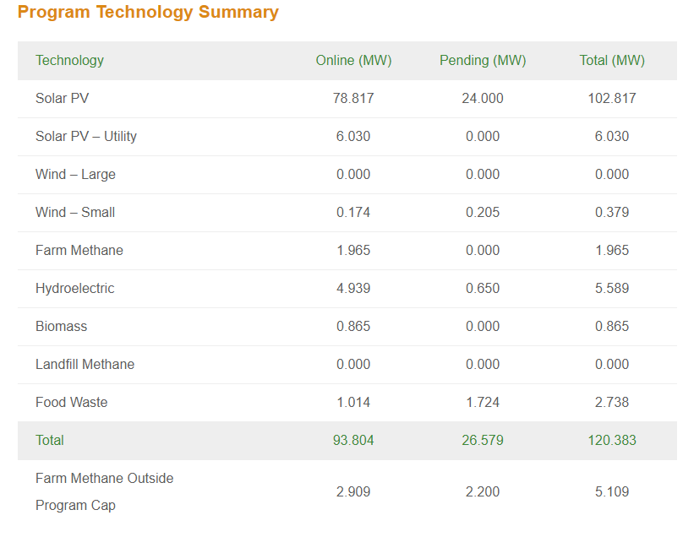
Standard Offer Program By the Numbers
The majority of Standard Offer awards have been solar projects competing in the “Price Competitive Developer Block”
The “Technology Diversity Developer Block” and “Provider Blocks” have not been as heavily utilized
The technology diversity block provides value by encouraging technology with diverse output profiles, though some technologies need additional scrutiny

Slide 4
Standard Offer Program By the Numbers
Overall:
Capacity Awarded: 137MW across 78 projects
Capacity Connected: 76MW across 47 projects
Capacity in Development: 39MW across 18 projects
Capacity Withdrawn: 22MW across 13 projects
Since 2020:
11 of 14 projects have received a CPG (1 project did not file for a CPG, 1 CPG is pending, and 1 project withdrew)
Average of 16 months (range of 8 – 28) for CPGs to be awarded after the announcement of the Standard Offer winners

Slide 5
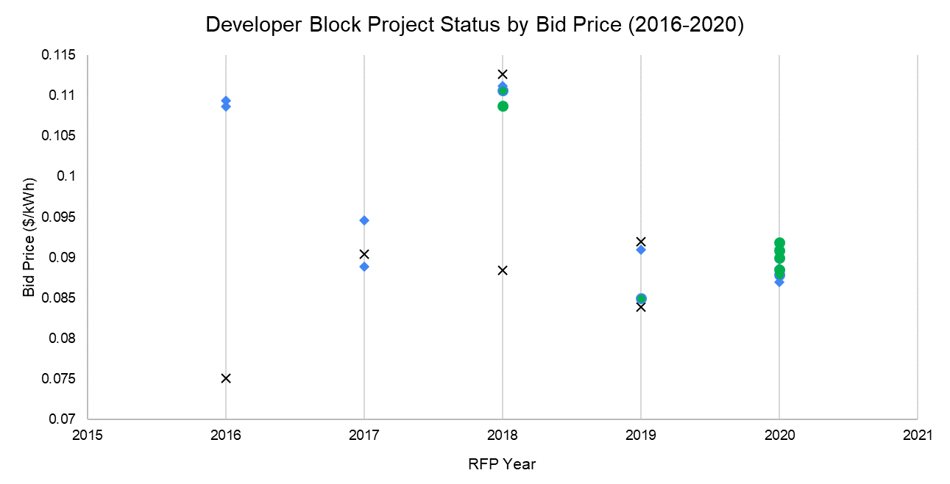
Outcome of Price Competitive Awards
Commissioned
In Development
Withdrawn

Slide 6
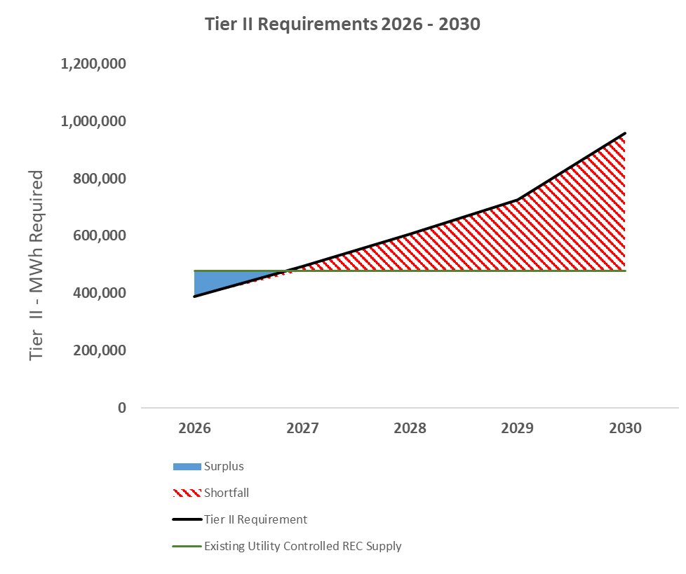
Reauthorized Standard Offer in the Context of the RES
By 2030 Vermont will require approximately 300 MW of additional distributed solar generation
REV’s proposal would put ~1/3 of that capacity into the Standard Offer program.

Slide 7
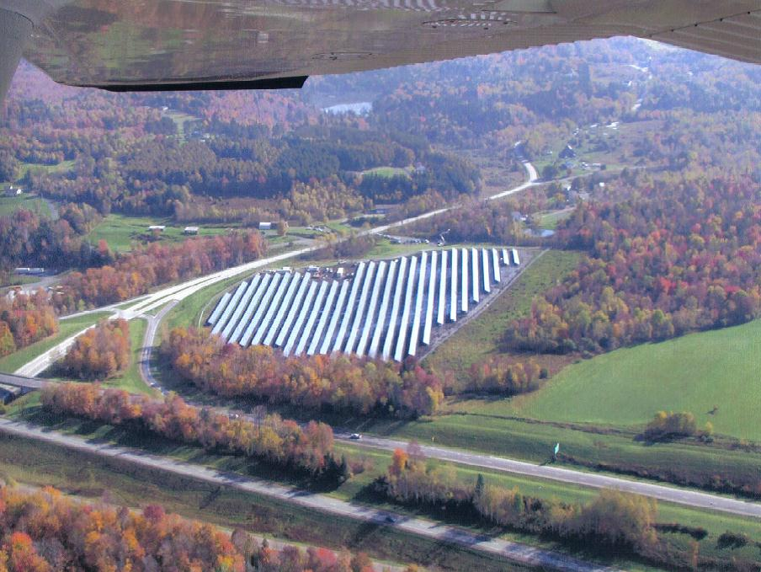
Reauthorizing Standard Offer in 2025
REV is seeking:
At least 100 MW of new Standard Offer Capacity
20MW/yr for five years
Biannual bidding process
Add a carve out for Community Solar – defined as projects owned by the project off-takers or an entity representing them
Eliminate Provider (utility) Block and allocations for technologies that emit greenhouse gases

Slide 8
Reauthorized Standard Offer
A reauthorized Standard offer:
Ensures the consistent and predictable deployment of new renewables and makes sure that early emissions reductions are achieved regardless of volatility in load growth
Recreates a space for community-owned renewables
Utilizes a mechanism that the Public Utility Commission has determined is consistent with the goal of timely development at the lowest feasible cost

